Slide 1
Aws cloudformation
@Amel Online

Slide 2
overview
AWS CloudFormation is a service that helps you model and set up your Amazon Web Services resources so that you can spend less time managing those resources and more time focusing on your applications that run in AWS.
You create a template that describes all the AWS resources that you want (like Amazon EC2 instances or Amazon RDS DB instances), and AWS CloudFormation takes care of provisioning and configuring those resources for you.

Slide 3
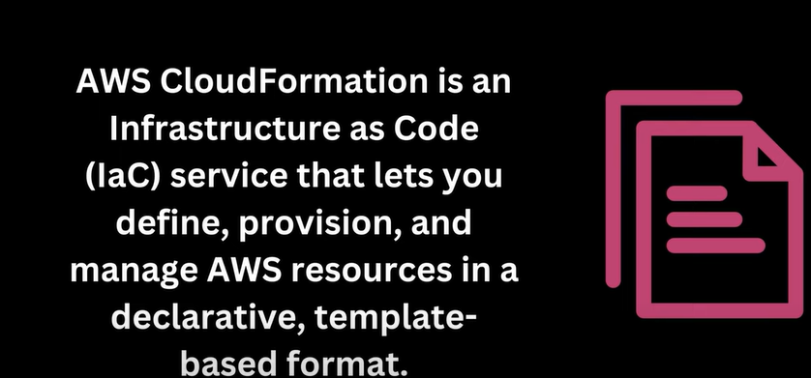
Definition

Slide 4
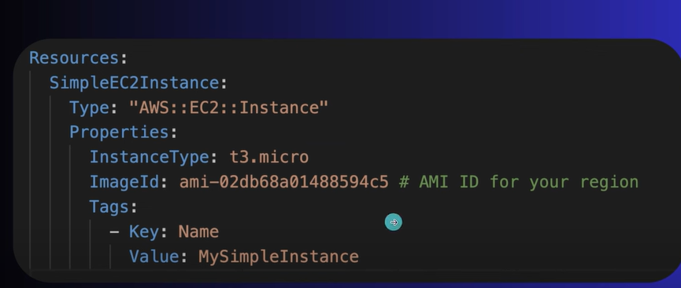
Template

Slide 5
..
Open your favorite text editor and create a CloudFormation template in either JSON or YAML format.
2. Define the structure of your CloudFormation template, which includes specifying the resources you want to create. For an EC2 instance, you should use the `AWS::EC2::Instance` resource type.
3. Define the properties for the EC2 instance, such as the instance type, key pair, security groups, and any other configuration details.

Slide 6
..
- Resources: These are the AWS resources you want to provision, such as EC2 instances, S3 buckets, RDS databases, etc.
— Parameters: These are input values that can be customized when creating a stack.
— Mappings: Define a mapping between input values and corresponding resource properties.
— Conditions: Specify when resources should be created or when they should be skipped.
— Outputs: Declare the values you want to retrieve once the stack is created.

Slide 7
AWS CloudFormation Basics:
In CloudFormation, you work with Templates and Stacks.
Template: JSON or YAML formatted text file which is a blueprint of your AWS resources.
Stack: In CloudFormation, you manage resources as a single unit called a Stack. All the resources in a stack are defined by the stack’s Template.
Hence the AWS CloudFormation workflow can be summarized using the image here.

Slide 8
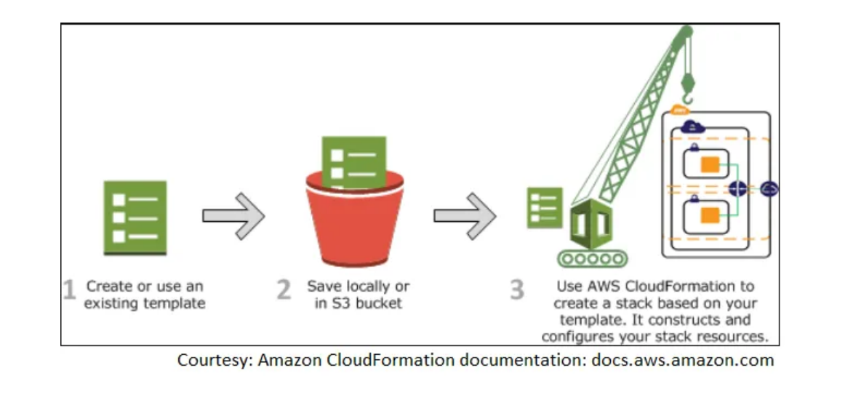
..

Slide 9
template
A template is a JSON or YAML formatted text file that describes what resources are contained in the Stack. It contains information about each resource, its configuration and how it may be connected or dependent on other resources.
A template can be developed using two methods:
1. UI Designer: You can diagram your template resources using a drag-and-drop interface, and then edit their details using the integrated JSON/YAML editor.
2. Script: Directly scripting the template in JSON or YAML format.

Slide 10
Description of template
Description: Enables you to include arbitrary comments about your template. (Optional)
Parameters: Parameters enable you to input custom values to your template each time you create or update a stack. (Optional)
Mappings: Collection of Key-Value pairs which can be used to set values. (Optional)
Resources: Declares the AWS resources that you want to include in the stack. (Required)
Outputs: Declares output values that you can import into other stacks, return in response, or view on the AWS CloudFormation console. (Optional)

Slide 11
benefit
Simplify Infrastructure Management
Quickly Replicate Your Infrastructure
Easily Control and Track Changes to Your Infrastructure

Slide 12
𝐃𝐫𝐢𝐟𝐭 𝐃𝐞𝐭𝐞𝐜𝐭𝐢𝐨𝐧:
- Drift detection in CFT allows you to identify differences between the desired stack configuration defined in your template and the current stack resources.
— It helps you track changes and understand if the stack has drifted from its expected state.
— Drift detection is useful for ensuring that your infrastructure stays compliant with your defined configurations.

Slide 13
𝐇𝐨𝐰 𝐭𝐨 𝐖𝐫𝐢𝐭𝐞 𝐂𝐅𝐓𝐬:
- Use the JSON or YAML template format to define your AWS resources, parameters, and other template components.
— Define the resource properties, dependencies, and other settings for each resource.
— Use CloudFormation intrinsic functions like `Fn::Ref`, `Fn::GetAtt`, and `Fn::Sub` for dynamic configurations.
— Use AWS-specific extensions like `!Sub` and `!ImportValue` for parameterization and cross-stack referencing.
— Use conditions to control resource creation and to make your templates more flexible.

Slide 14
𝐄𝐱𝐚𝐦𝐩𝐥𝐞𝐬 𝐨𝐟 𝐂𝐥𝐨𝐮𝐝𝐅𝐨𝐫𝐦𝐚𝐭𝐢𝐨𝐧 𝐔𝐬𝐞 𝐂𝐚𝐬𝐞𝐬:
- Creating a VPC and related resources: Define a VPC, subnets, security groups, and routing tables.
— Deploying an application stack: Define EC2 instances, load balancers, databases, and other application components.
— Setting up monitoring and alarms:*Define CloudWatch alarms, SNS topics, and metric filters.
— Provisioning storage resources: Define S3 buckets, EBS volumes, and RDS databases.
— Managing security and compliance: Define IAM roles, policies, and security group rules.

Slide 15
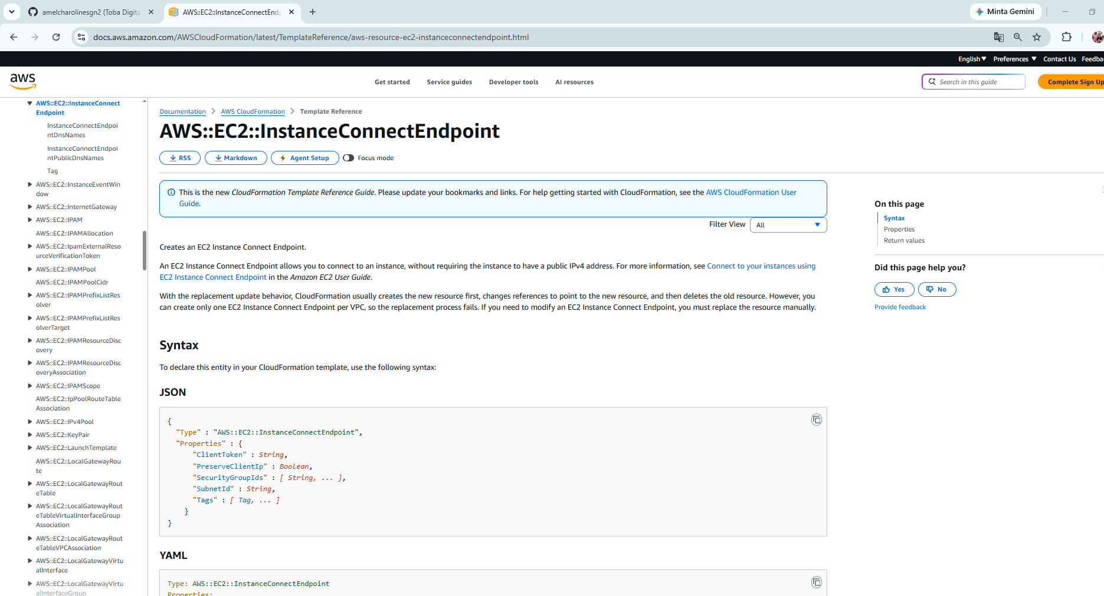
Lab
https://docs.aws.amazon.com/AWSCloudFormation/latest/UserGuide/aws-resource-ec2-instanceconnectendpoint.html

